Slide 1
Complete Coverage Path Planning
Kaifu jiang
Kun Han

Slide 2
Outline:
Quick intro to the problem & our solution.
- Step 1: Divide the area into sub-areas.
- Step 2: Generate covering path for each sub-area.
- Step 3: Connect all paths.
- Step 4: Parallelization.
A quick example.

Slide 3
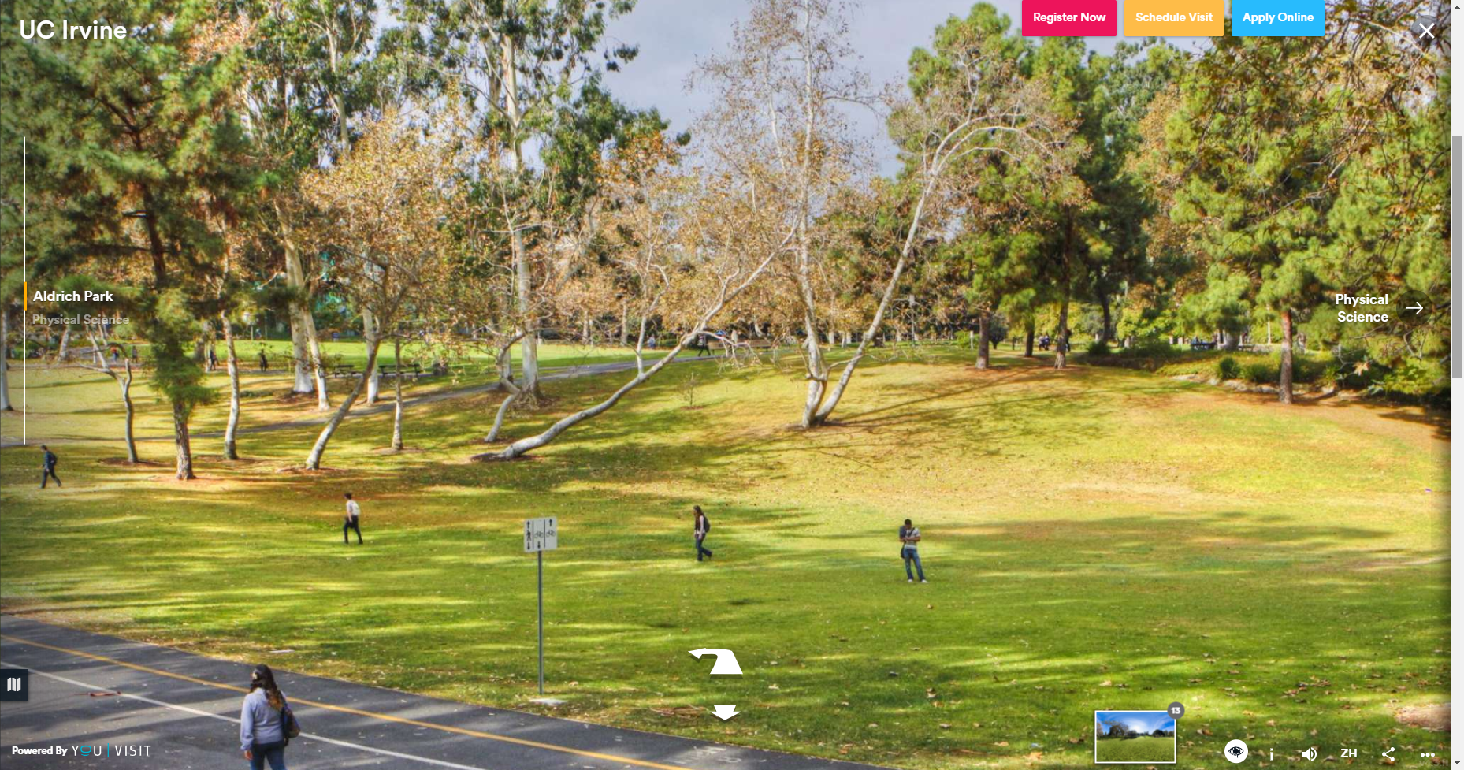
1) Intro to the problem
Generate a covering path for an area like this.

Slide 4
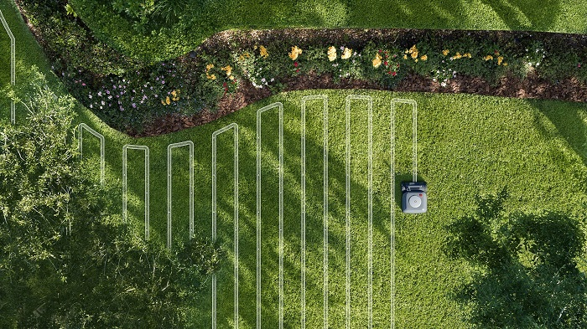
1) Intro to the problem
The path should look like this. (try to include as less turns as possible)

Slide 5
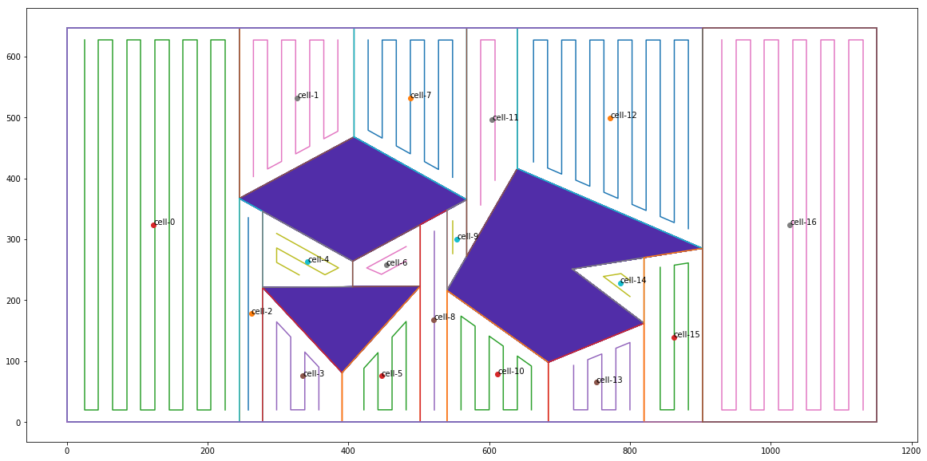
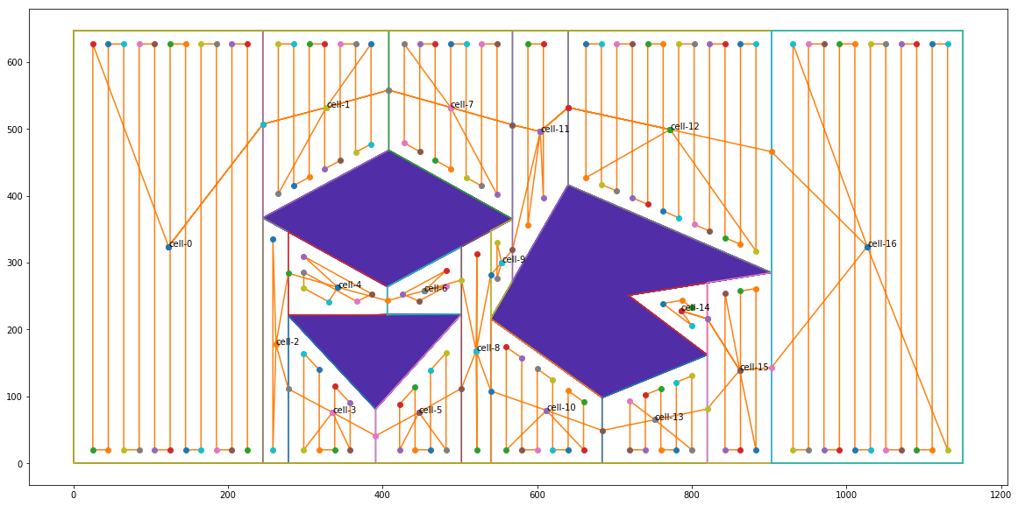
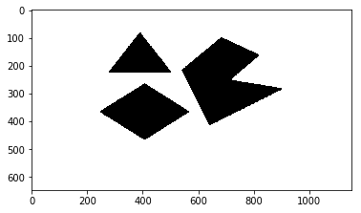
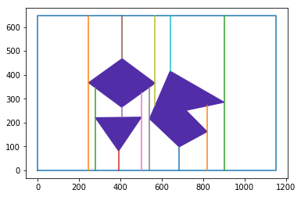
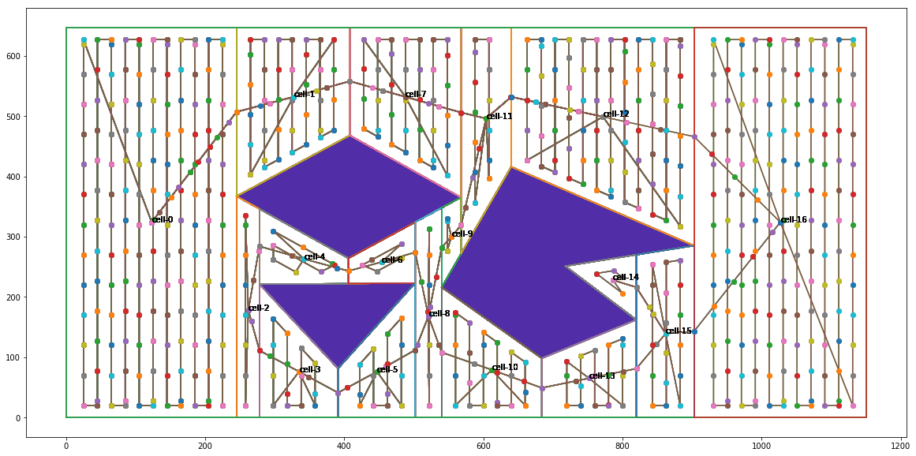
1) Intro to our solution
Parallelize some of the procedures.

Slide 6
Step 4: Parallelization.

Slide 7
generate_cells
generate_node_set
generate_path
83%

Slide 8
extract_vertex
get_vertical_line
generate_naive_polygon
refine_polygon
generate_cell
66.67%

Slide 9
Level 1: Naïve parallelism
create
join -> create
join -> create
join
Use queue and lock to communicate among processes

Slide 10
#############################################
MP_naive:
extract_vertex_mp
time: 1.8201844692230225
get_vertical_line_mp
time: 2.8649649620056152
generate_naive_polygon_mp
time: 3.1596450805664062
refine_quad_cells_mp
time: 14.845367670059204
generate_node_set_mp
time: 8.617656230926514
generate_path_mp
time: 12.870764970779419
Total time: 44.17858338356018
#############################################

Slide 11
Level 2: Use Pool and Manager
create
join
Manager -> Shared memory among all the processes

Slide 12
#############################################
MP_Manager_Pool:
extract_vertex_mp
time: 0.010967254638671875
get_vertical_line_mp
time: 0.0498809814453125
generate_naive_polygon_mp
time: 0.13163256645202637
refine_quad_cells_mp
time: 0.5465390682220459
generate_node_set_mp
time: 0.03690600395202637
generate_path_mp
time: 0.06582427024841309
Total time: 0.8417501449584961
#############################################

Slide 13
Level 3: Add work unit to Pool
create
join
Manager -> Shared memory among all the processes
Add work unit to mp functions

Slide 14
################
Parallel execution
################
############ Inside generate_cells function ############
extract_vertex_mp
time: 0.0
get_vertical_line_mp
time: 0.04686307907104492
generate_naive_polygon_mp
time: 0.09372949600219727
refine_quad_cells_mp
time: 0.42177653312683105
########################################################
generate_cells_mp
time: 0.5936136245727539
generate_node_set_mp
time: 0.062489986419677734
generate_path_mp
time: 0.06249570846557617
Total time without process start and end: 0.7498338222503662
Total time: 2.202620506286621
path generated

Slide 15
################
Serial execution
################
############ Inside generate_cells function ############
extract_vertex_se
time: 0.0
get_vertical_line_se
time: 0.015609025955200195
generate_naive_polygon_se
time: 0.07808542251586914
refine_quad_cells_se
time: 0.0
########################################################
generate_cells_se
time: 0.09369444847106934
generate_node_set_se
time: 0.015627622604370117
generate_path_se
time: 0.0
Total time: 0.12496781349182129
path generated

Slide 16
A quick example.

Slide 18
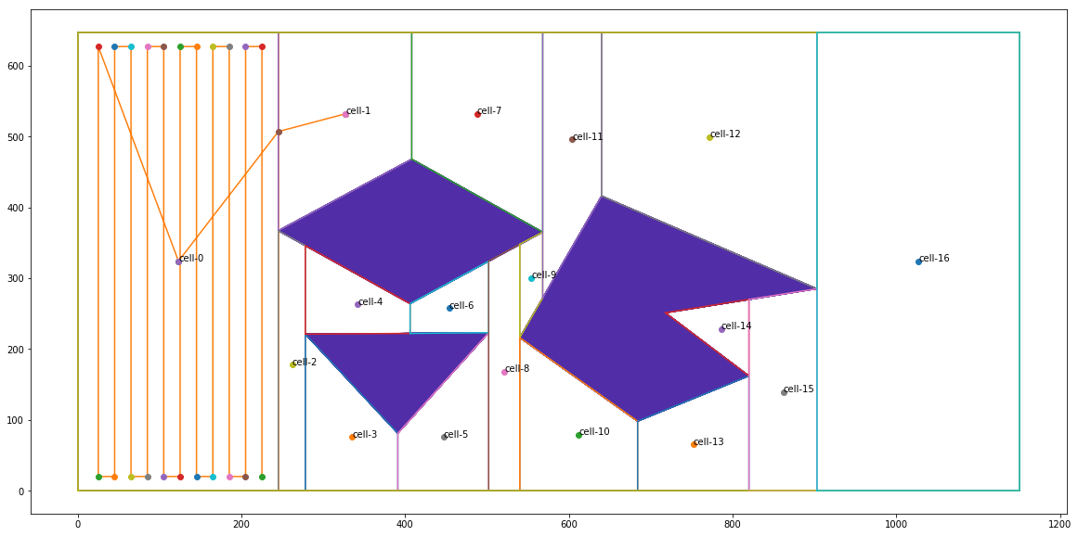

Slide 19
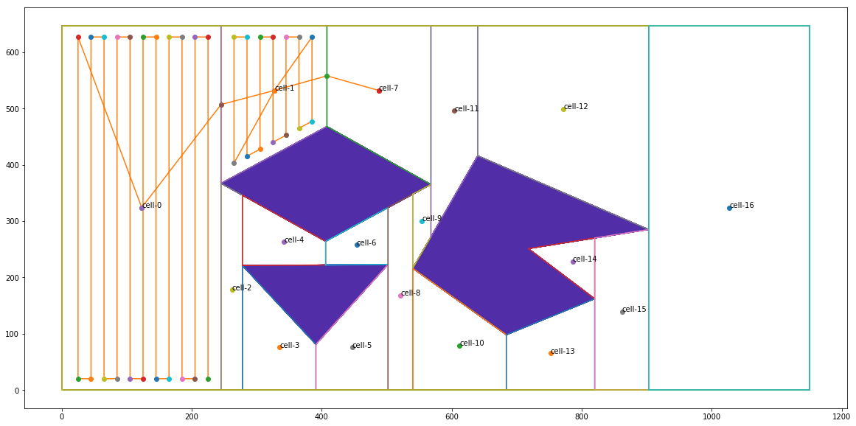

Slide 20


Slide 21
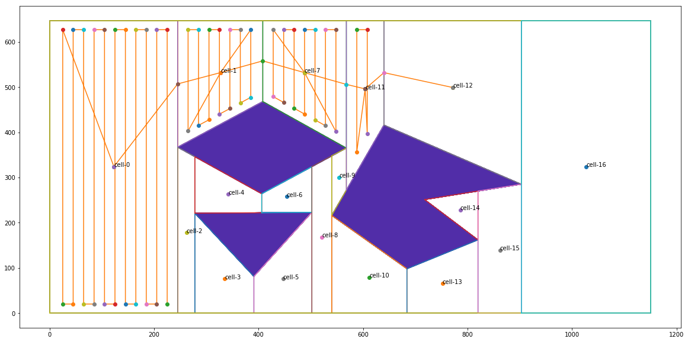

Slide 22
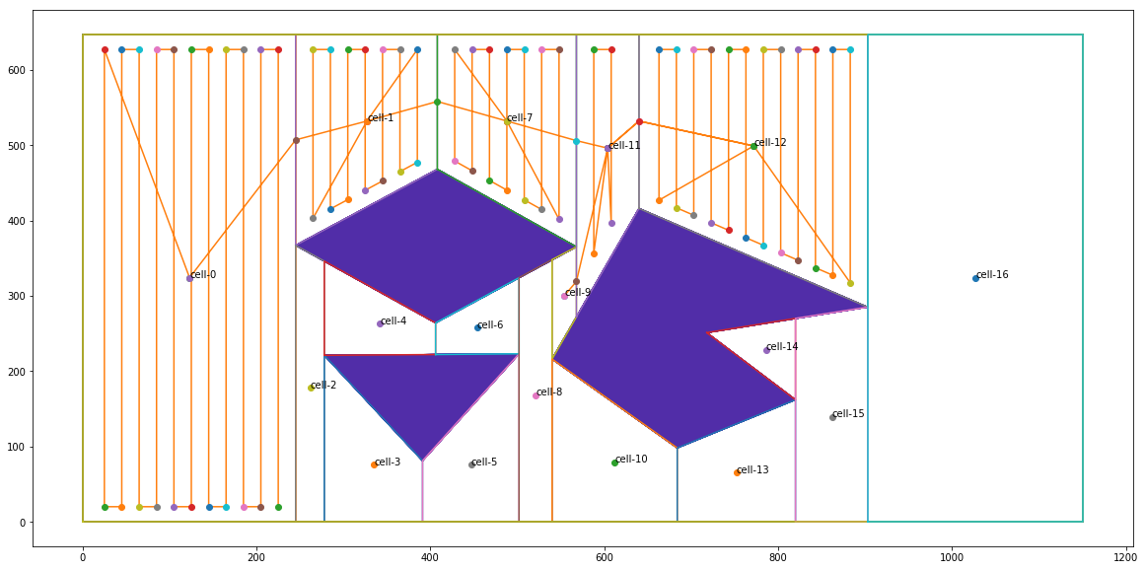

Slide 23


Slide 24


Slide 25
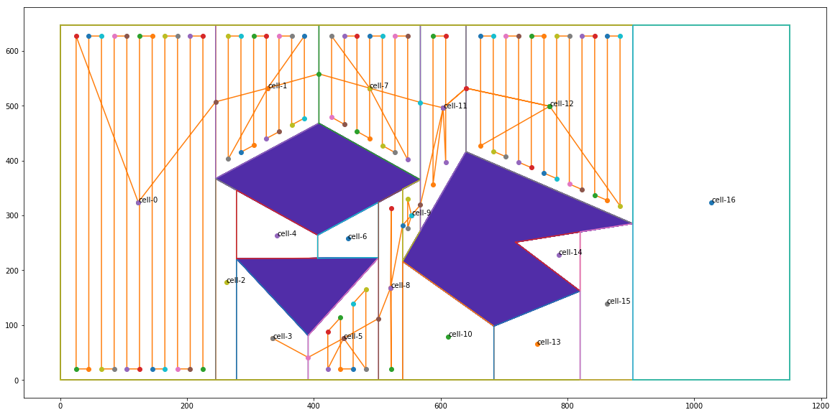

Slide 26
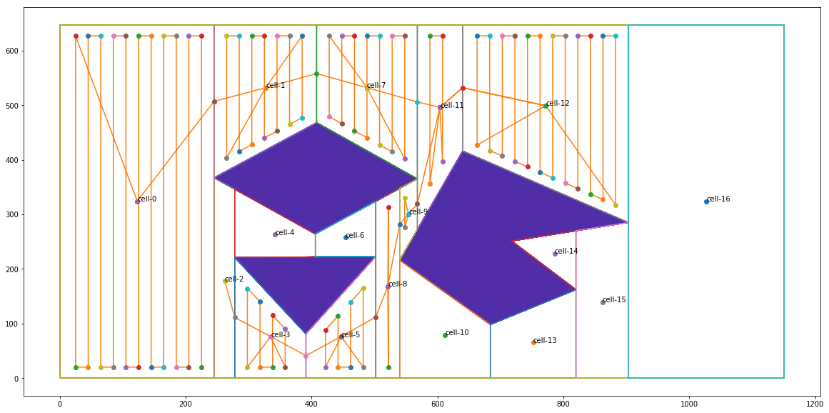

Slide 27
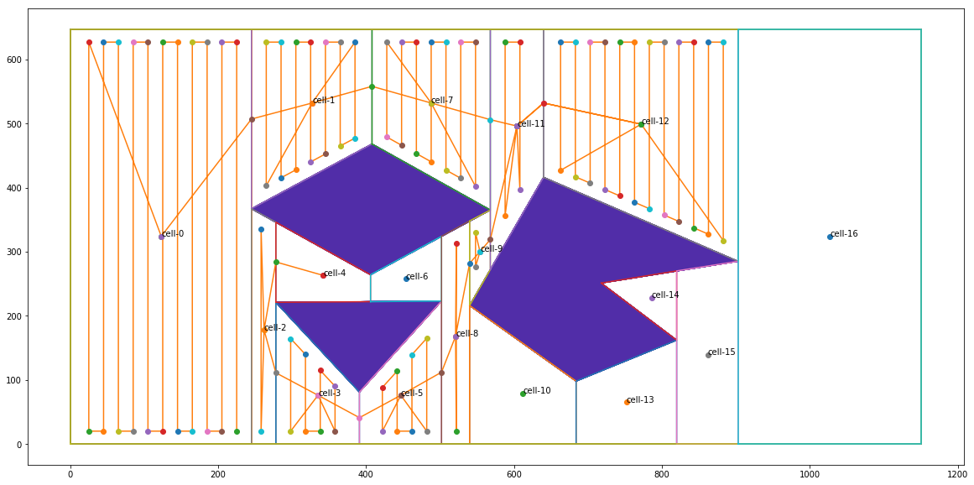

Slide 28


Slide 29


Slide 30
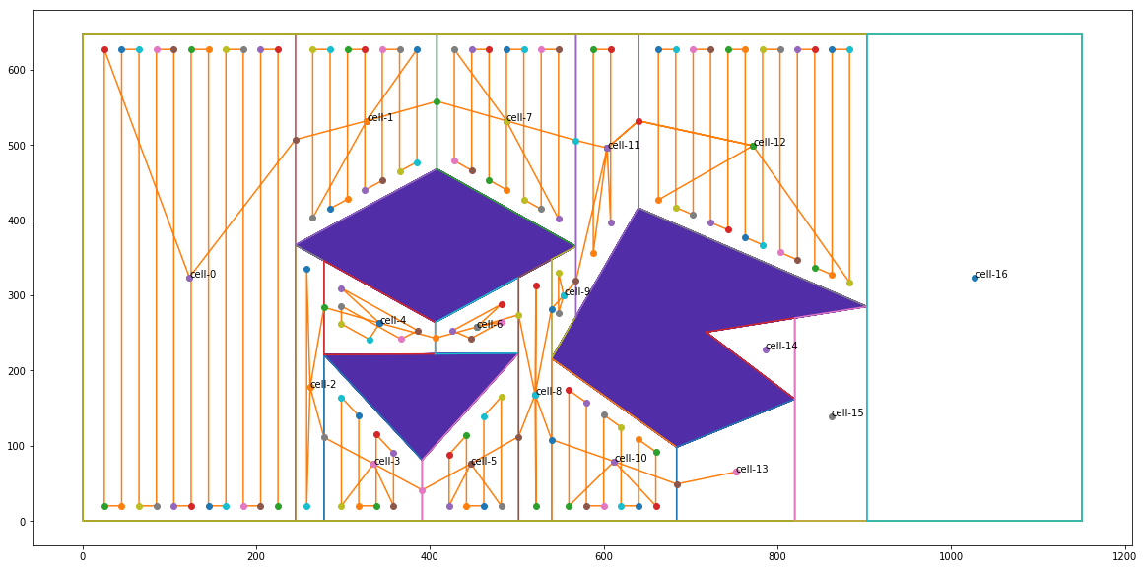

Slide 31


Slide 32


Slide 33


